Slide 1

SYLIP CORPORATION
ANNUAL SALES PERFORMANCE REPORT FROM 2010 - 2017
DATA TYPE: ANNUAL SALES DATA
REPORTING CYCLE: 2010 – 2017
PRESENTED BY: ROTIMI FAWUMI (TEAM LEAD)

Slide 2
GROUP NAME AND TEAM MEMBERS
Group 1
Rotimi Fawumi (Team Lead)
Funmilayo Raphael (Member)

Slide 3
ORIGINAL BENCH-MARK
Annual Total Cost Target = $1,500,000.00
Annual Total Profit Target = $2,500,000.00
Annual Revenue (Sales) Target = $3,000,000.00
Annual Units Sold (Qty) Target = 15,000

Slide 4
KEY PERFORMANCE INDICATORS
Compute total profit from all regions
Calculate total revenue made annually
Rate of total revenue in all regions
Average number of item types sold annually
Top 4 countries with highest and lowest revenue.
Determine revenue growth rate year on year

Slide 5
TERMINOLOGIES
Total Revenue : This the total income that accrues to a firm from the sales of all the units of its products.
Total Revenue = Unit Price * Units Sold
Total Cost: This is the summation of all the resources used in the production of goods and the provision of services.
Total Cost = Unit Cost * Units Sold
Total Profit is the excess above total cost.
Total Profit= Total Revenue – Total Cost

Slide 6
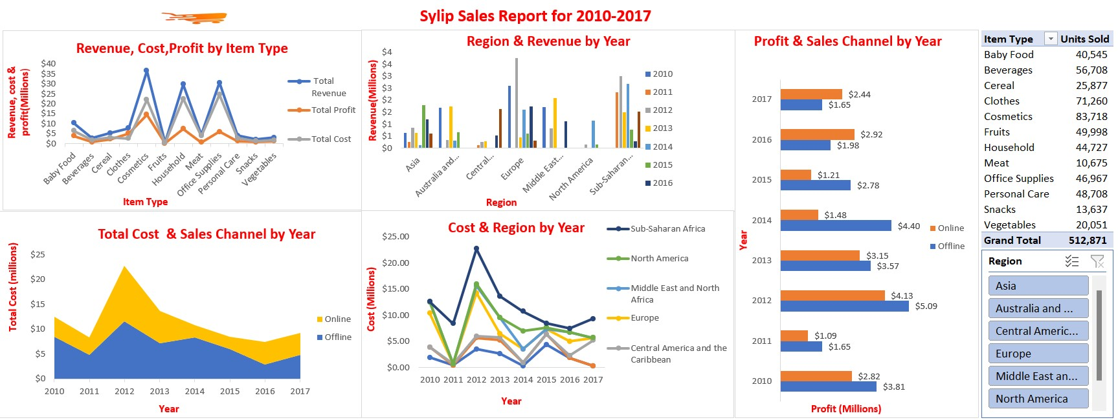

Slide 7
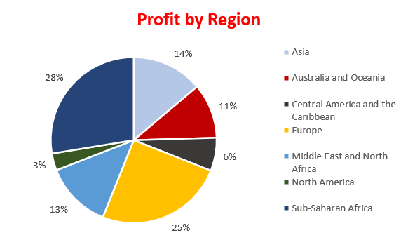
KPI 1: Total Profit from all Regions
SUMMARY REPORT
From the period under review:
Total profit achieved is $44,168,198.40.
The region with the highest profit is Sub Sahara Africa with $12,183,211.40 while the region with the lowest profit is North America with $1,457,942.76

Slide 8
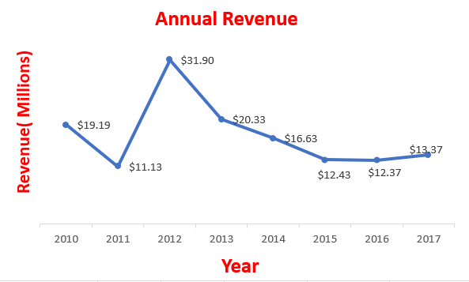
KPI 2 : Total Revenue made Annually
SUMMARY REPORT
From the 2010-2017, the highest revenue was made in 2012 which was $31,898,644.52
The year with the least revenue was 2011 which was $11,129,166.07
There has been continuous decline in revenue from 2012

Slide 9
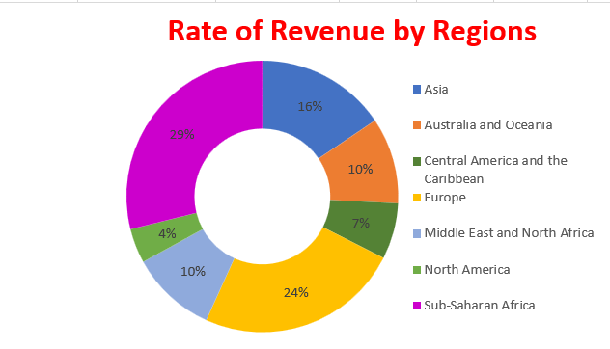
KPI 3 : Rate of Total Revenue in all Regions
SUMMARY REPORT
3 regions accounted for 69% of the total revenue for all regions.
The difference between the highest rate of revenue and the least is 25%

Slide 10
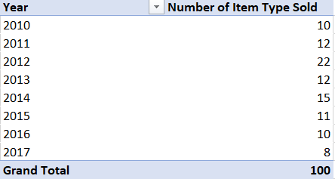
KPI 4 : Average Number of Items Sold Annually
SUMMARY REPORT
The average number of items sold annually was approximately 13 between 2010 to 2017
The highest items sold was 22 at 2012 while lowest is 8 at 2017

Slide 11
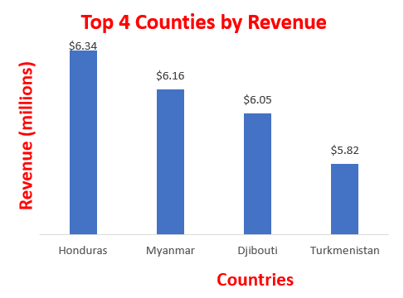
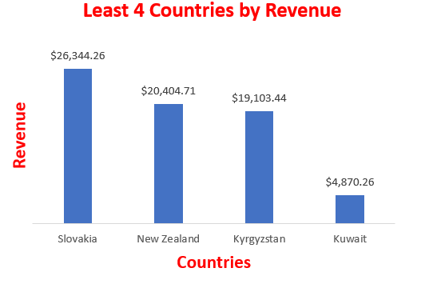
KPI 5 : Top 4 Countries with Highest and Lowest Revenue.
SUMMARY REPORT
Honduras has the highest revenue while Kuwait has the least revenue for the countries under review.
The highest revenue was $6.34 million while the least revenue was $4,870.26
Honduras accounted for 4.61% of the total revenue for the countries under review in all regions.

Slide 12
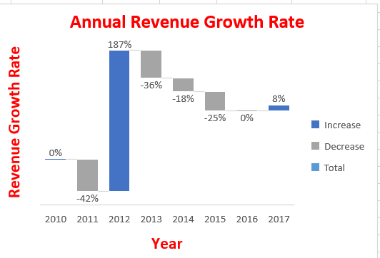
KPI 6 : Determine Revenue Growth Rate Year on Year
SUMMARY REPORT
It was observed that 2012 and 2017 were the years that revenue growth occurred with 187% and 8% growth rates respectively.
2011 had the highest decline in revenue while 2012 had the highest revenue growth rate with 2010 breaking even
There was a continuous decline in revenue growth rate from 2013 to 2016.

Slide 13
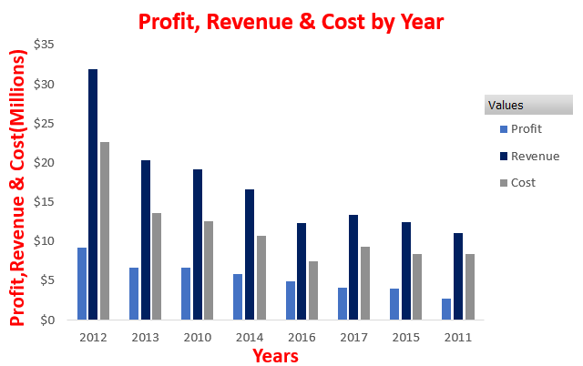
KPI 7 : Profit, Revenue & Cost by Year
SUMMARY REPORT
2012, 2013 and 2010 are the top 3 years with the highest revenue, cost and profit.
In 2016 there was a deviation in cost from the observed pattern from the other years.
2011 had the least profit despite having almost the same revenue and cost with 2015 to 2017.

Slide 14
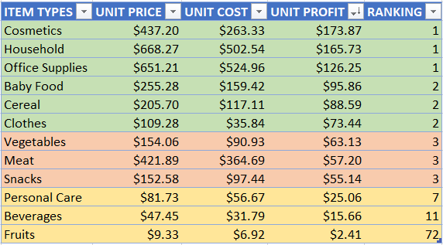
KPI 8: Items Types, Unit Cost & Unit Price by Unit Profit.
SUMMARY REPORT
From the table the items with the highest unit profits margin are Cosmetics, Household, Office supplies and Baby food respectively while Fruits and Beverages had the lowest unit profit margin.
For every unit Cosmetic sold at a profit of $173.87, Sylip cooperation have to sell 72 units of Fruits, 11 units of Beverages, 7 units of Personal Care and 3 units of Snacks to break even with Cosmetic unit price at their unit prices of $2.41, $15.66, $25.06 and $55.14 respectively.
The ranking shows 3 category of the item types by profit contribution estimated using:
Rank = (cosmetics unit profit)/(other item unit profit)

Slide 15
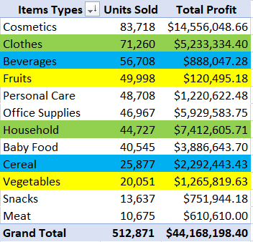
KPI 9 : Item Types & Units Sold by Total Profit
SUMMARY REPORT
From the table the items with the highest profits are Cosmetics, Household, Office supplies and Clothes respectively while Snacks and Meat had the lowest profit.
A deep dive into the data shows units sold does not translate into profit except for Cosmetics which is an outlier with the highest units sold and the highest profit.
There is an inverse relationship between quantity sold and profit for most of the items on the table as highlighted in some of the rows on the table.

Slide 16
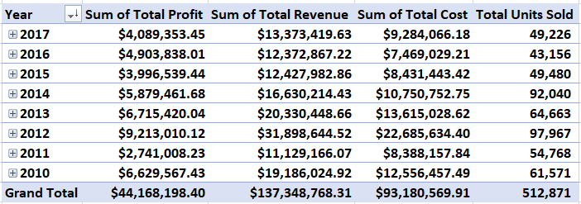
PROPOSED BENCH-MARK (QUANTITY-BASED)
The proposed bench-mark was suggested based on the overall average cost, revenue, profit and units sold from 2010-2017. The proposition of the bench-mark below are solely on the quantities of the units sold with respect to the year under review.
Annual Total Cost Target = $11,647,571.24
Annual Total Profit Target = $5,521,024.80
Annual Revenue (Sales) Target = $17,168,596.04
Annual Units Sold (Qty) Target = 42,739

Slide 17
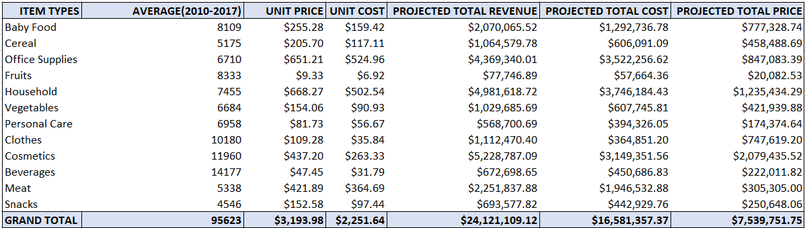
PROPOSED BENCH MARK(QUALITY-BASED):
The proposed bench-mark was suggested based on the average cost, revenue, profit and units sold of each item types
individually from 2010-2017. The proposition of the bench-mark below are solely on the uniqueness of each item types
contribution. Analysis is subjected and limited by the data and information available at our disposal at the time of compilation and analysis.
Annual Total Cost Target = $16,581,357.37
Annual Total Profit Target = $7,539,751.75
Annual Revenue (Sales) Target = $24,121,109.12
Annual Units Sold (Qty) Target = 95,623

Slide 18
Benchmarks comparison
Original Benchmark | Proposed Benchmark (Quantity-Based) | Proposed Benchmark (Quality-Based)
Annual Total Cost Target = $1,500,000.00 Annual Total Profit Target = $2,500,000.00 Annual Revenue (Sales) Target = $3,000,000.00 Annual Units Sold (Qty) Target = 15,000 | Annual Total Cost Target = $11,647,571.24 Annual Total Profit Target = $5,521,024.80 Annual Revenue (Sales) Target = $17,168,596.04 Annual Units Sold (Qty) Target = 42,739 | Annual Total Cost Target = $16,581,357.37 Annual Total Profit Target = $7,539,751.75 Annual Revenue (Sales) Target = $24,121,109.12 Annual Units Sold (Qty) Target = 95,623
It is obvious from the above comparison subject to the data and information given and analyzed that: Sylip cooperation
bench-marking an decision making should be quality based. Each item type should be treated with its own unique
Nature and contribution to the firm growth.
Executives and leadership of Sylip cooperation needs to do a thorough research on each item types, We strongly suggest
it should be categorized into groups with respect to quantity, quality and contribution (individual and overall) to growth;
for instance KPI 8 shows categorization of item types into 3, ranked by their unit profit contributions.

Slide 19
RECOMMENDATION
A new bench mark should be set on the basis of uniqueness of each Item types rather than lumping all items in terms of quantity of units sold at the expense of quality of each item type’s contribution to cost, revenue and profitability.
A cost minimization strategy needs to be introduce to reduce the cost of business operation, the rate of revenue to cost is 69%.
There is necessity to focus on marketing and sales of products that are highly profitable in all regions all year round, that includes products such as Cosmetics, Household, Office supplies, Clothes and Cereals.
Sylip data shows that Items such as Household and Personal care have high sales offline since customers prefer to see before purchasing, consistent use of both sales channels across all regions all year round should be taken seriously.
Each region’s data should be monitored independently by the regional sales manager since each region is peculiar and distinct.
Items such as meat, snacks and vegetables have low profit yet they are food items which are usually purchased daily, unlike cosmetics, office supplies, household and clothes which has high profit but are not purchased daily. Therefore a fresh marketing strategy that will increase the sales of food items should be implemented.

Slide 20
CONCLUSION
The cost of operation for both sales channel (Offline & Online) is high, if profit is to be maximized, then an effective and efficient cost minimization strategy should be formulated and implemented.
With the implementation of the new bench mark and effective marketing campaign for all their product across all regions, revenue and profit will increase by 202% comparing original benchmark
to quality-based benchmark.
Consistency across all regions with the use of both sales channel will increase revenue by 41% comparing the quantity based to quality based benchmark however there is going to be a HUGE 472% increase in revenue comparing original benchmark to quantity-based benchmark and an INCREDIBLE 704% increase in revenue across all regions when original bench mark is compared to adoption of quality based benchmark.

Slide 21
Thank You Any Question?

Slide 22
APPENDIX

Slide 23
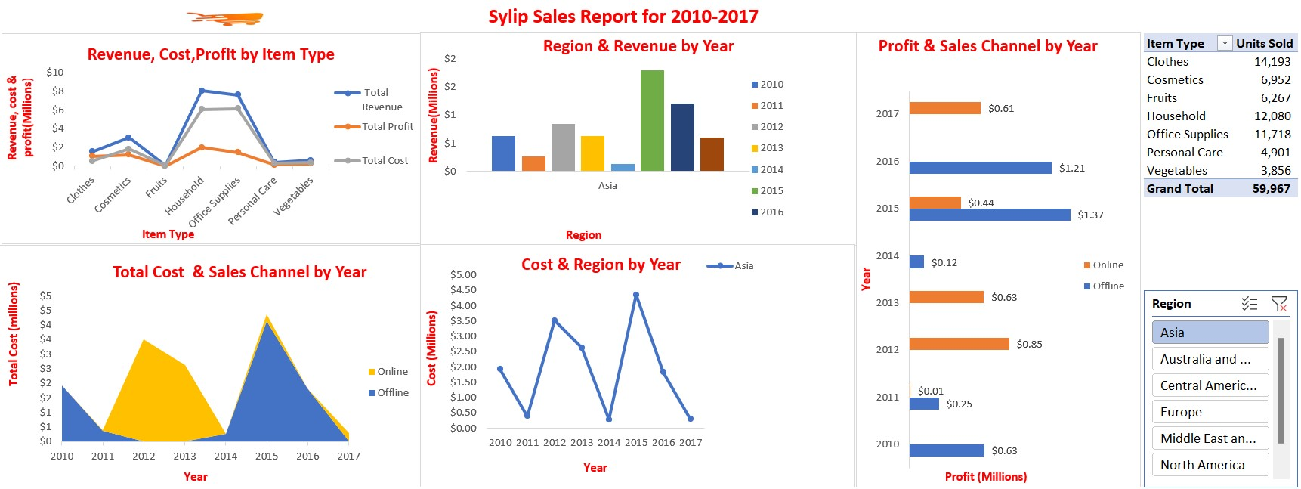

Slide 24
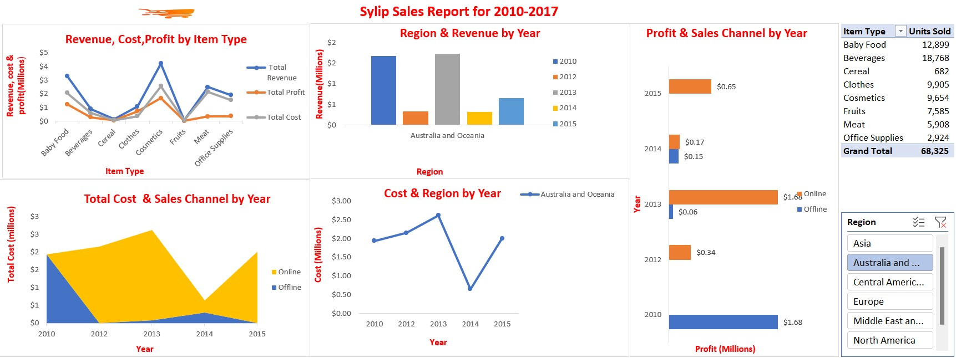

Slide 25
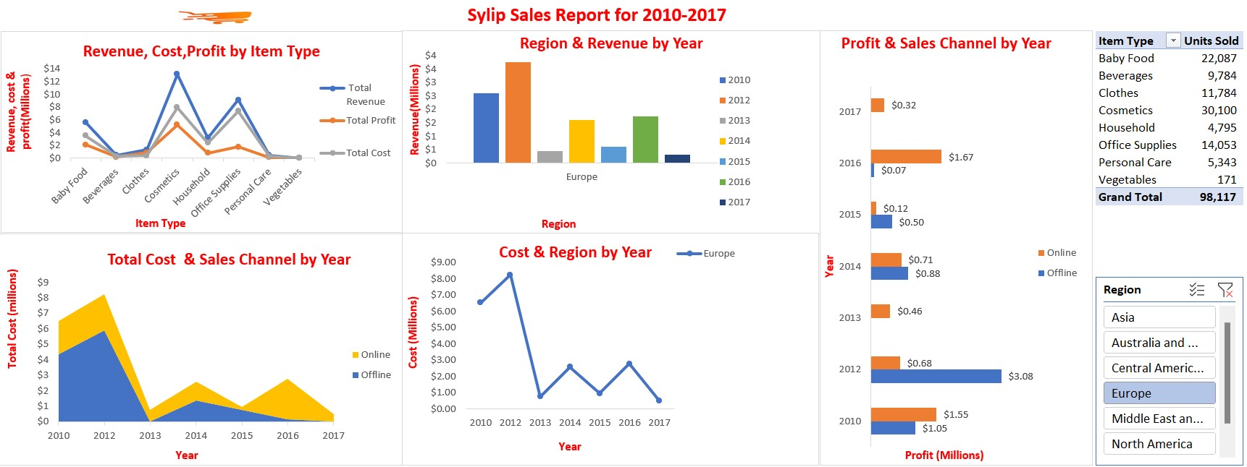

Slide 26
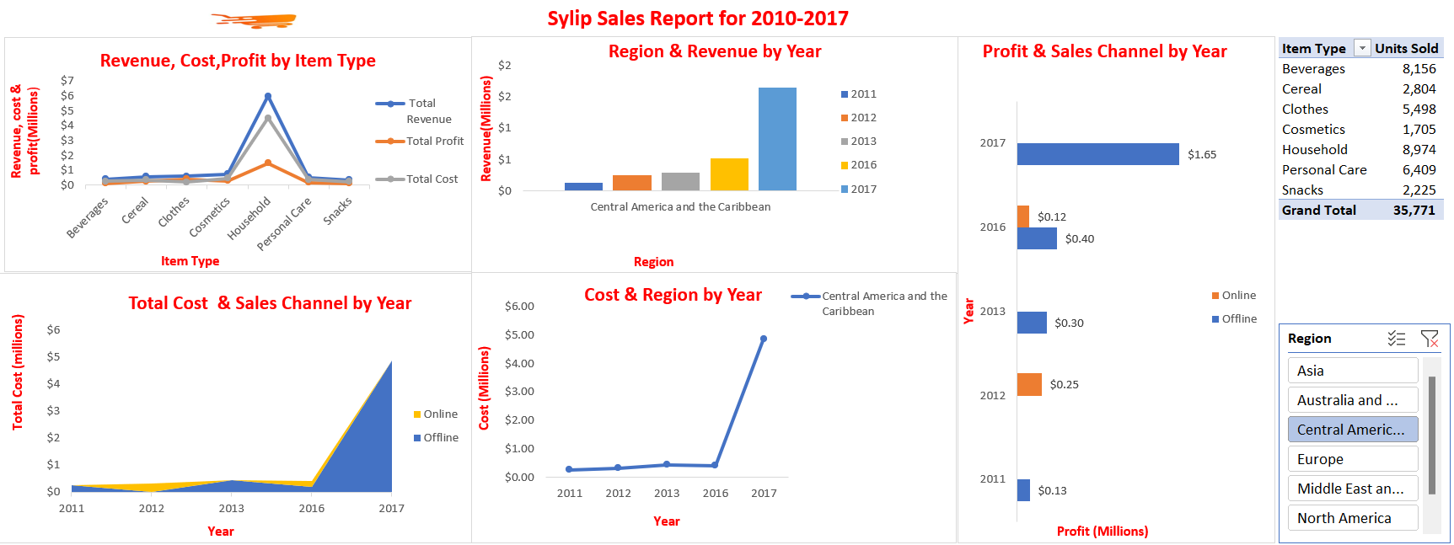

Slide 27
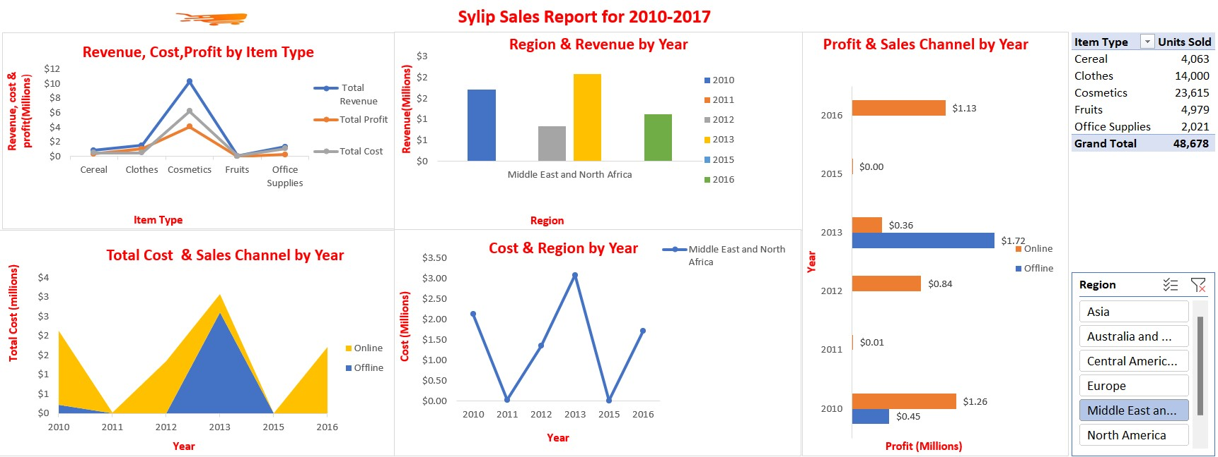

Slide 28
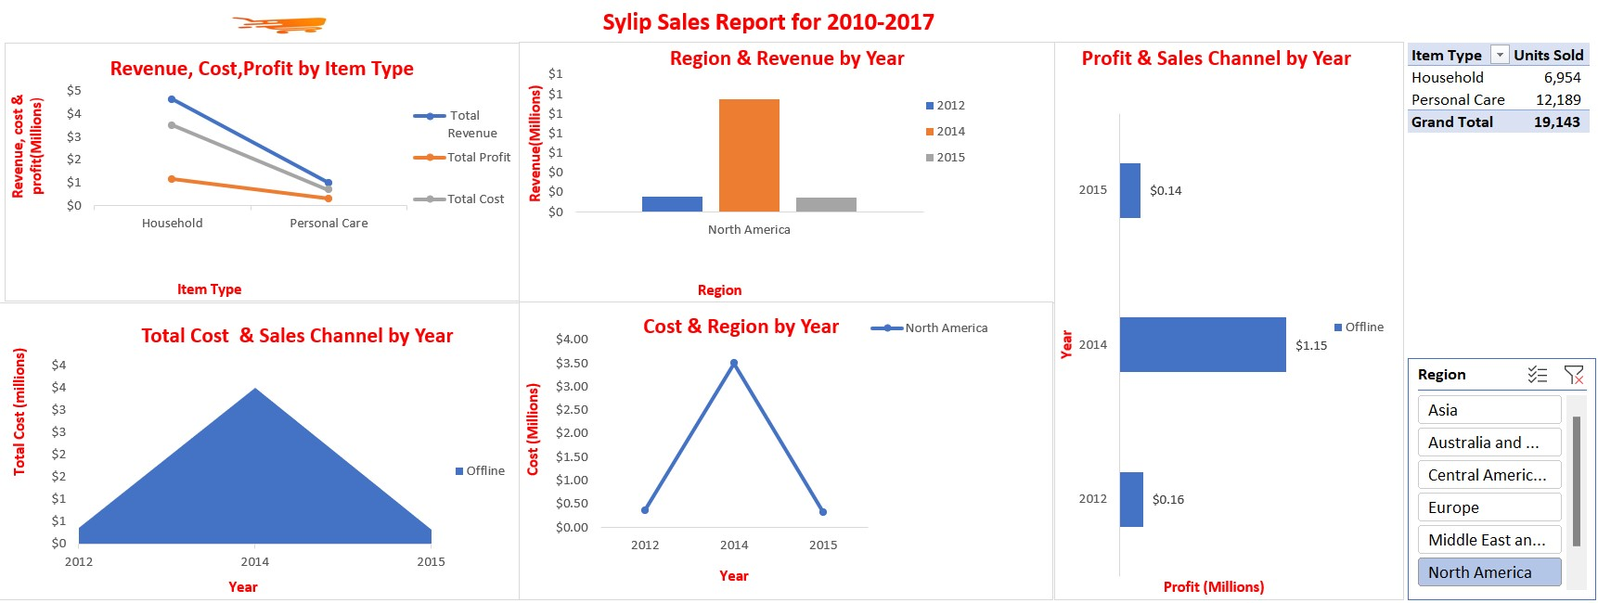

Slide 29
